Slide 1

Geometry
Unit 13, Lesson 3 Determining Points on a Circle Volume 2, pg. 294

Slide 2


Benchmarks
MA.912.GR.3.2
Given a mathematical context, use coordinate geometry to classify or justify definitions, properties, and theorems involving circles, triangles, or quadrilaterals.
MA.912.GR.3.3
Use coordinate geometry to solve mathematical and real-world geometric problems involving lines, circles, triangles, and quadrilaterals.
MA.912.GR.7.2
Given a mathematical or real-world context, derive and create the equation of a circle using key features.
volume 2, pg. 294

Slide 3
Integrated Mathematical Thinking and Reasoning Standards
MA.K12.MTR.1.1 Actively participate in effortful learning both individually and collectively.
MA.K12.MTR.2.1 Demonstrate understanding by representing problems in multiple ways.
MA.K12.MTR.4.1 Engage in discussions that reflect on the mathematical thinking of self and others.
MA.K12.MTR.5.1 Use patterns and structure to help understand and connect mathematical concepts.
MA.K12.MTR.6.1 Assess the reasonableness of solutions.
volume 2, pg. 294

Slide 4

Learning Targets
I can determine whether a point is on a circle, in a circle, or outside a circle.
I can find the center of a circle when given two points.
I can write the equation of a circle given the endpoints of a diameter.
volume 2, pg. 294

Slide 5

Warm-Up
volume 2, pg. 294

Slide 6
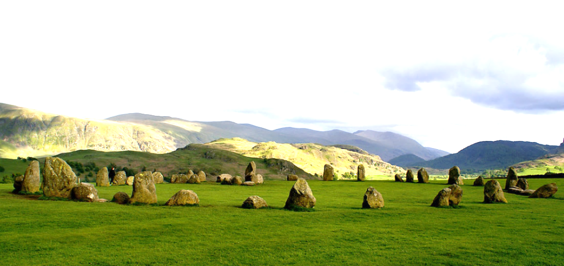
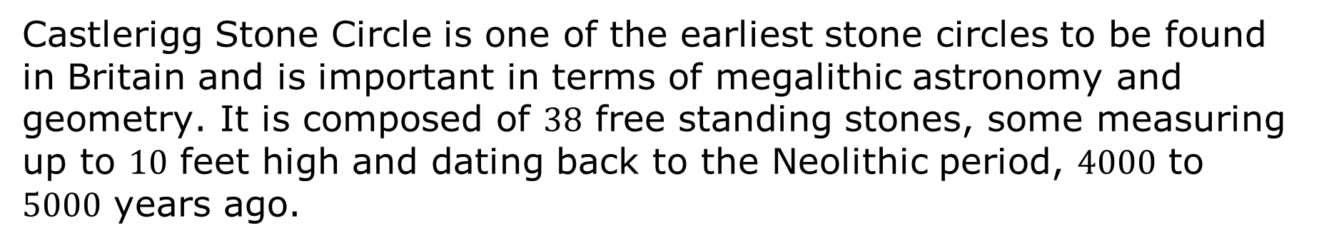
13.3.1 Warm-Up: Notice and Wonder
Castlerigg Stone Circle is one of the earliest stone circles to be found in Britain and is important in terms of megalithic astronomy and geometry. It is composed of $38$ free standing stones, some measuring up to $10$ feet high and dating back to the Neolithic period, $4000$ to $5000$ years ago.
volume 2, pg. 294

Slide 7
What do you notice?
What do you wonder?
volume 2, pg. 294

Slide 8

Exploration
volume 2, pg. 295

Slide 9

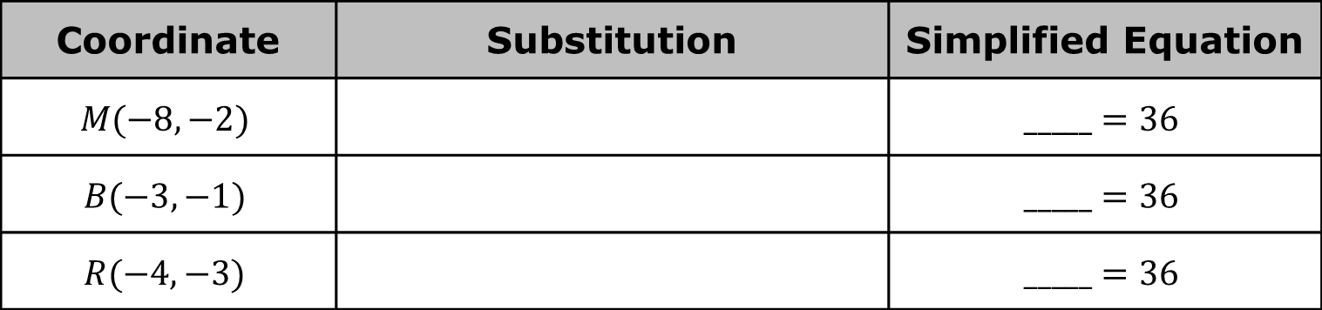
13.3.2 Exploration: Points on a Circle
The equation of circle 𝐻 is ${\left(x+4\right)}^{2}+{\left(y−3\right)}^{2}=36$.
Complete the table by substituting the given coordinates for 𝑥 and 𝑦 in the equation of circle 𝐻. Then, determine the value of the left side of the equation to complete the simplified equation in the last column.
What do you notice about the simplified equations?
Coordinate | Substitution | Simplified Equation
$$M(−8,−2)$$ |  | $$_____=36$$
$$B(−3,−1)$$ |  | $$_____=36$$
$$R(−4,−3)$$ |  | $$_____=36$$
volume 2, pg. 295

Slide 10
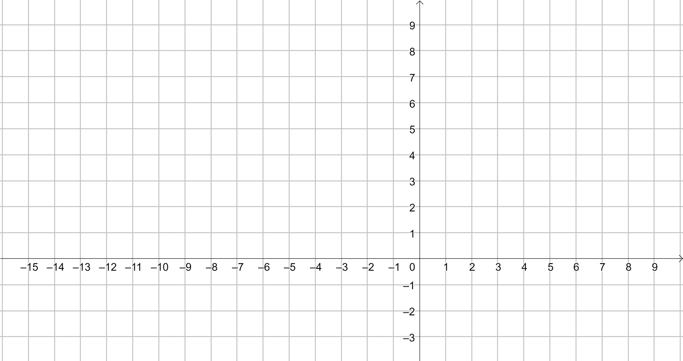

Graph circle 𝐻, ${\left(x+4\right)}^{2}+{\left(y−3\right)}^{2}=36$.
Plot points $M(−8,−2)$, $B(−3,−1)$, and $R(−4,−3)$.
volume 2, pg. 295

Slide 11
What do you notice about the relationship between the location of the points and their simplified equations?
Write a conjecture about the location of a point and the equation of the circle.
volume 2, pg. 295

Slide 12
Ask two classmates for their conjectures. Record their conjectures and write your summary of their conjecture. You are the only person who should write in the first two columns of the table. Have the person initial next to your summary stating that your summary was correct.
Review your conjecture with your partner. If necessary, make any changes.
Conjecture | My Summary of Their Conjecture | Initials
volume 2, pg. 296

Slide 13
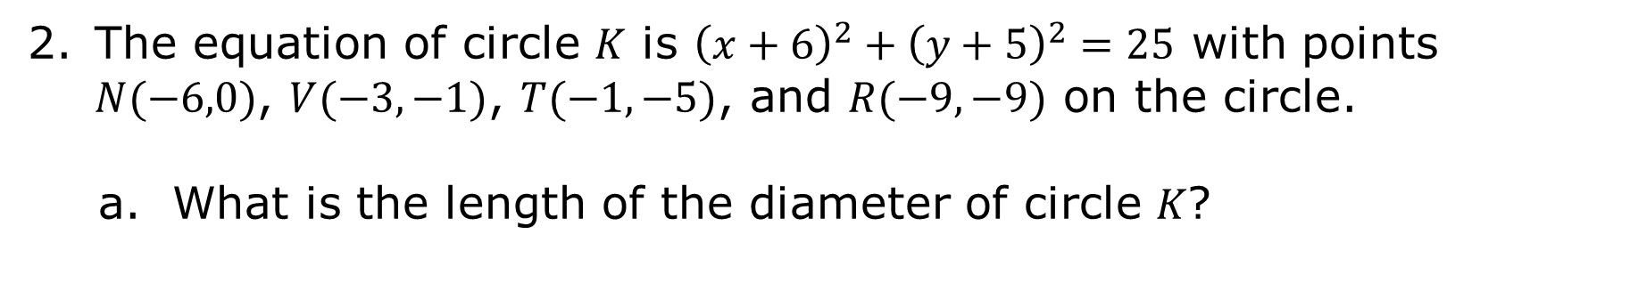
The equation of circle 𝐾 is ${\left(x+6\right)}^{2}+{\left(y+5\right)}^{2}=25$ with points $N(−6,0)$, $V(−3,−1)$, $T(−1,−5)$, and $R(−9,−9)$ on the circle.
What is the length of the diameter of circle 𝐾?
volume 2, pg. 296

Slide 14
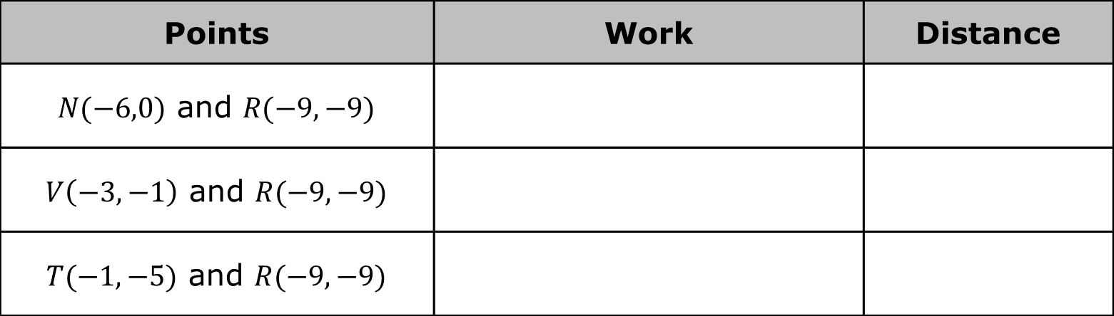
Complete the table by finding the distance between the given points.
What do you notice about the distances between the points?
What can you conclude about points 𝑉 and 𝑅?
Points | Work | Distance
$N(−6,0)$ and $R(−9,−9)$
$V\left(−3,−1\right)$ and $R(−9,−9)$
$T(−1,−5)$ and $R(−9,−9)$
volume 2, pg. 296

Slide 15
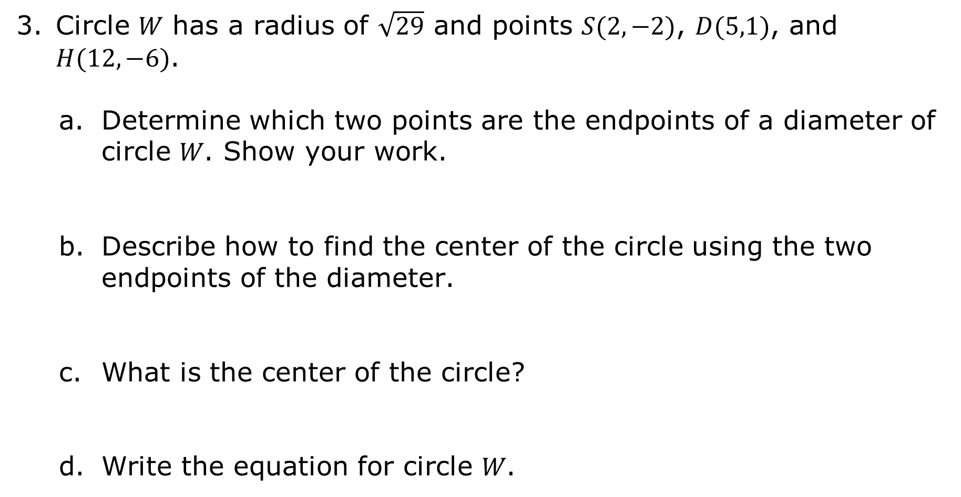
Circle 𝑊 has a radius of $\sqrt{29}$ and points $S(2,−2)$, $D(5,1)$, and $H(12,−6)$.
Determine which two points are the endpoints of a diameter of circle 𝑊. Show your work.
Describe how to find the center of the circle using the two endpoints of the diameter.
What is the center of the circle?
Write the equation for circle 𝑊.
volume 2, pg. 297

Slide 16
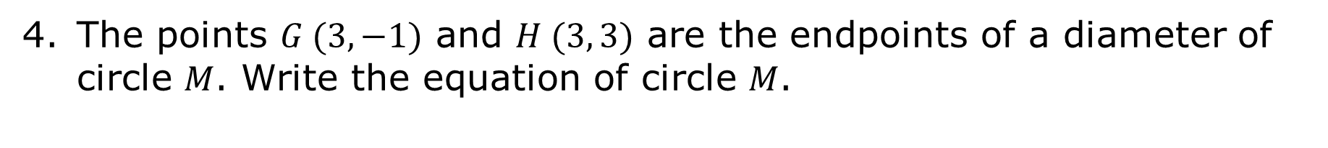
The points $G (3, −1)$ and $H (3, 3)$ are the endpoints of a diameter of circle 𝑀. Write the equation of circle 𝑀.
volume 2, pg. 297

Slide 17

Try It
volume 2, pg. 298

Slide 18
13.3.3 Try It: Points on a Circle
The equation of circle 𝑃 is ${\left(x−8\right)}^{2}+{\left(y−2\right)}^{2}=13$.
volume 2, pg. 298

Slide 19
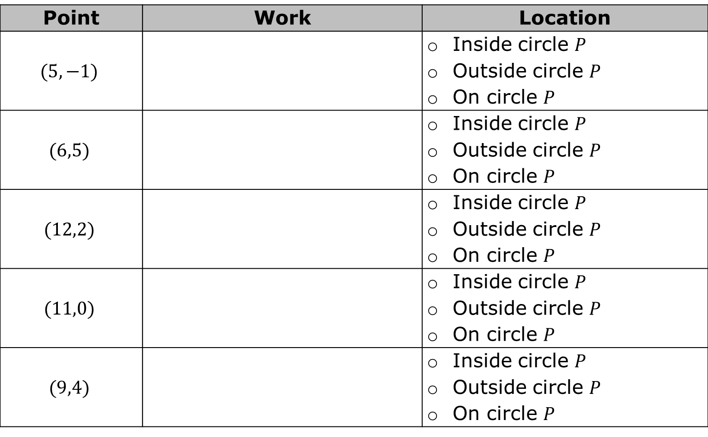
Determine whether the following points lie inside, outside, or on circle 𝑃.
Point | Work | Location
$$(5,−1)$$ |  | Inside circle $P$ Outside circle $P$ On circle $P$
$$(6,5)$$ |  | Inside circle $P$ Outside circle $P$ On circle $P$
$$(12,2)$$ |  | Inside circle $P$ Outside circle $P$ On circle $P$
$$(11,0)$$ |  | Inside circle $P$ Outside circle $P$ On circle $P$
$$(9,4)$$ |  | Inside circle $P$ Outside circle $P$ On circle $P$
volume 2, pg. 298

Slide 20
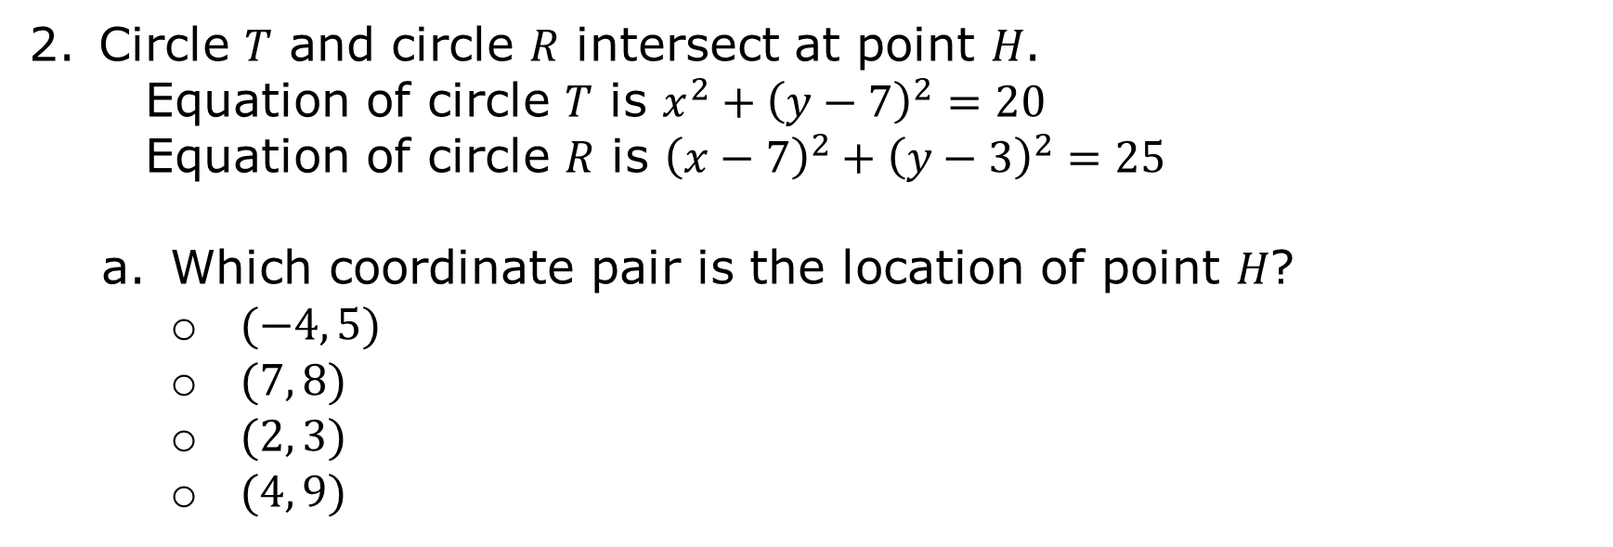
Circle 𝑇 and circle 𝑅 intersect at point 𝐻.
Equation of circle 𝑇 is $x^{2}+{\left(y−7\right)}^{2}=20$
Equation of circle 𝑅 is ${\left(x−7\right)}^{2}+{\left(y−3\right)}^{2}=25$
Which coordinate pair is the location of point 𝐻?
$(−4, 5)$
$(7, 8)$
$(2, 3)$
$(4, 9)$
volume 2, pg. 298

Slide 21
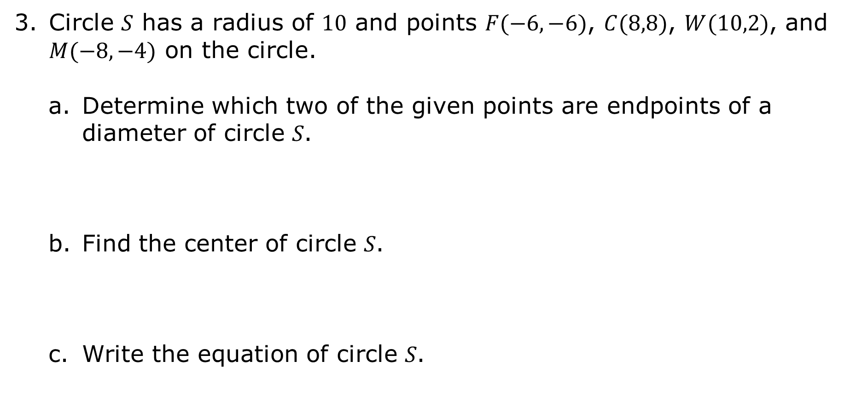
Circle 𝑆 has a radius of $10$ and points $F(−6,−6)$, $C(8,8)$, $W(10,2)$, and $M(−8,−4)$ on the circle.
Determine which two of the given points are endpoints of a diameter of circle 𝑆.
Find the center of circle 𝑆.
Write the equation of circle 𝑆.
volume 2, pg. 298

Slide 22

Wrap-Up
volume 2, pg. 299

Slide 23
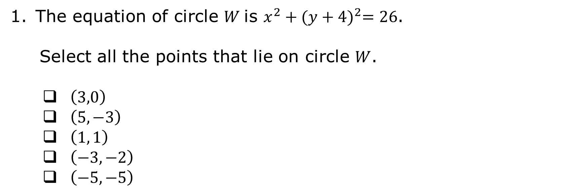
13.3.4 Wrap-Up: Ticket Out the Door
The equation of circle $W$is $x^{2}+{(y+4)}^{2}=26$.
Select all the points that lie on circle $W$.
$\left(3,0\right)$
$\left(5,−3\right)$
$\left(1, 1\right)$
$\left(−3,−2\right)$
$\left(−5,−5\right)$
volume 2, pg. 299

